Slide 1
AI PROJECT PLAN 2026
Prepared by : Carl

Slide 2
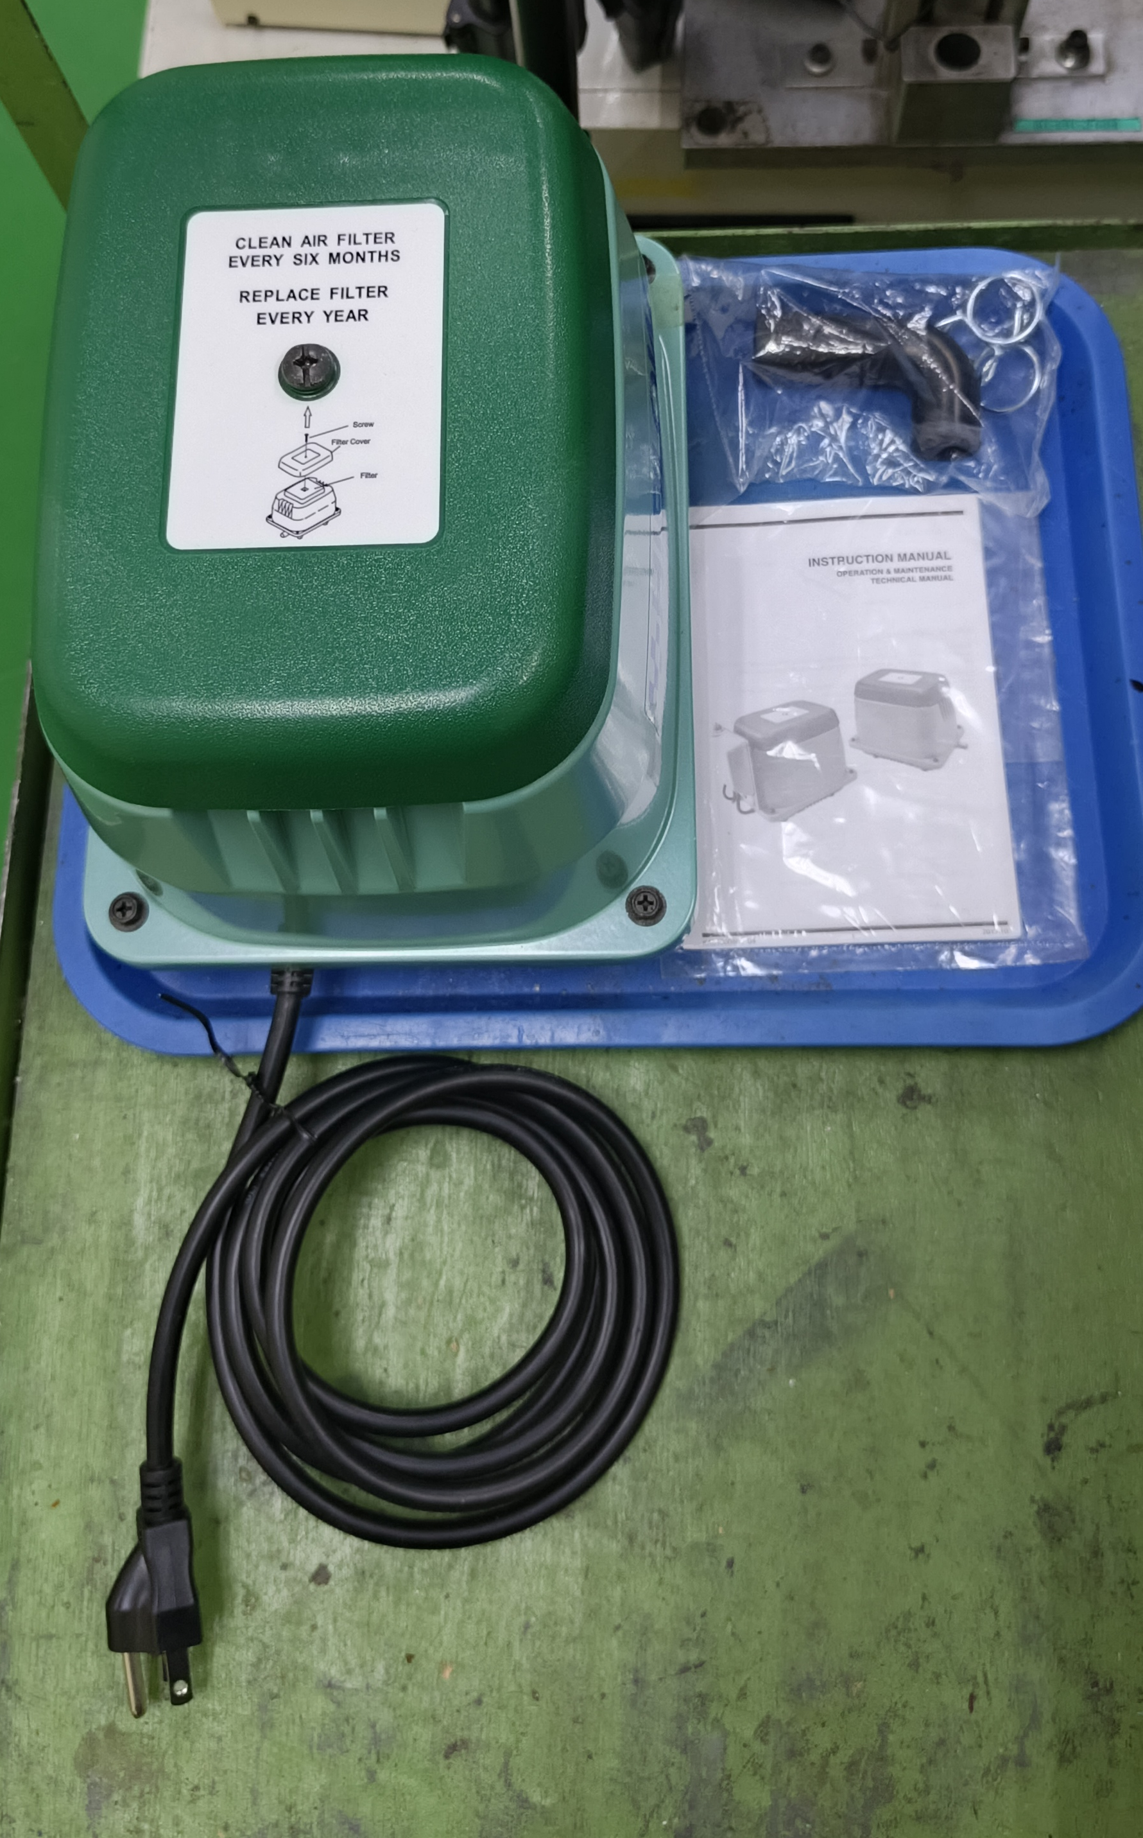



Used For Annotation
Used For Learning
Dataset (Images To Learning)
100 – 200 Images
Object Detection

Slide 3
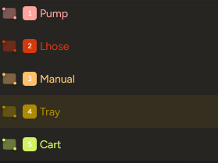
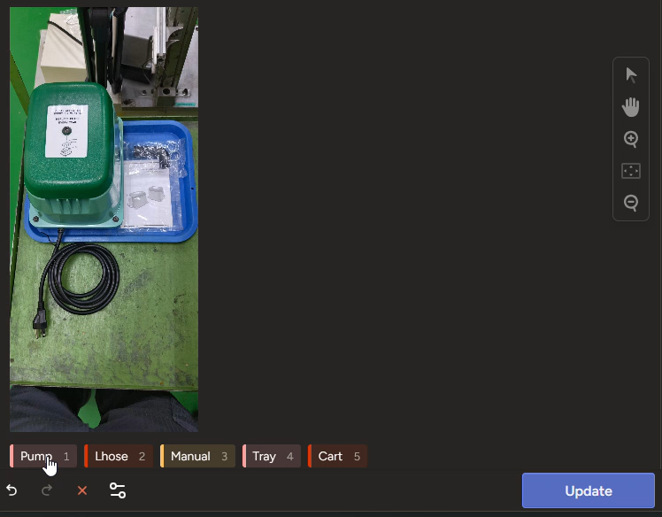
Add Object Label To Detect
Highlight Object With Corresponding Label

Slide 4
Used For Annotation
Used For Learning
Dataset (Images To Learning)
100 – 200 Images
Object Detection

Slide 5
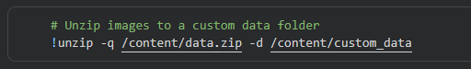

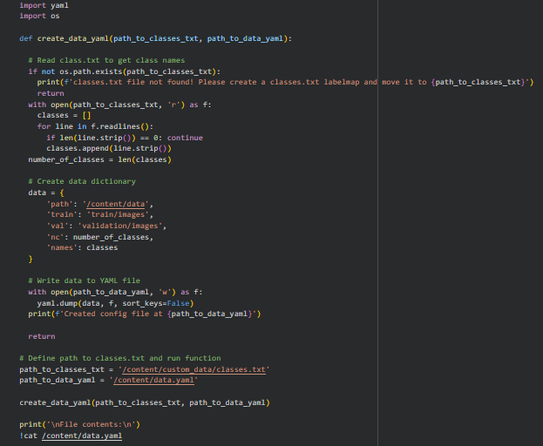

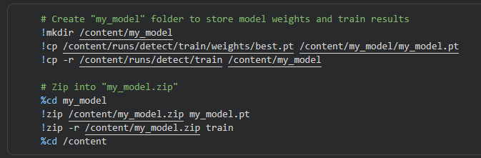
This is the codebase for learning the annotated dataset currently running in google collab

Slide 6
Used For Annotation
Used For Learning
Dataset (Images To Learning)
100 – 200 Images
Object Detection

Slide 7
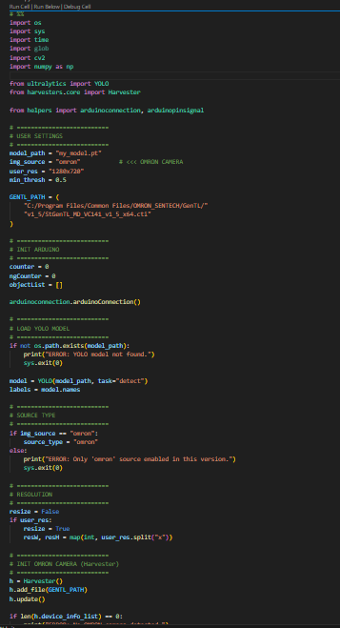
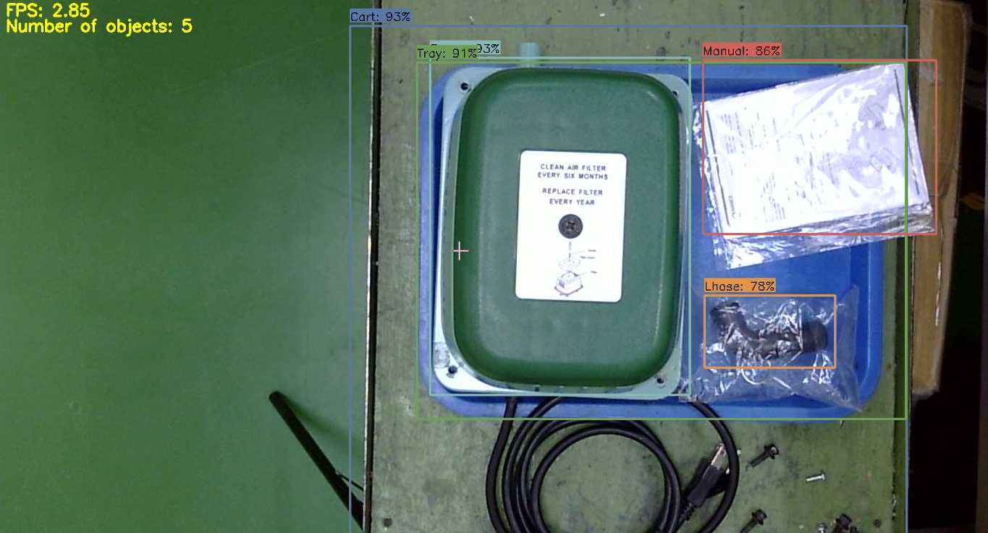
This is the codebase for object detection

Slide 8
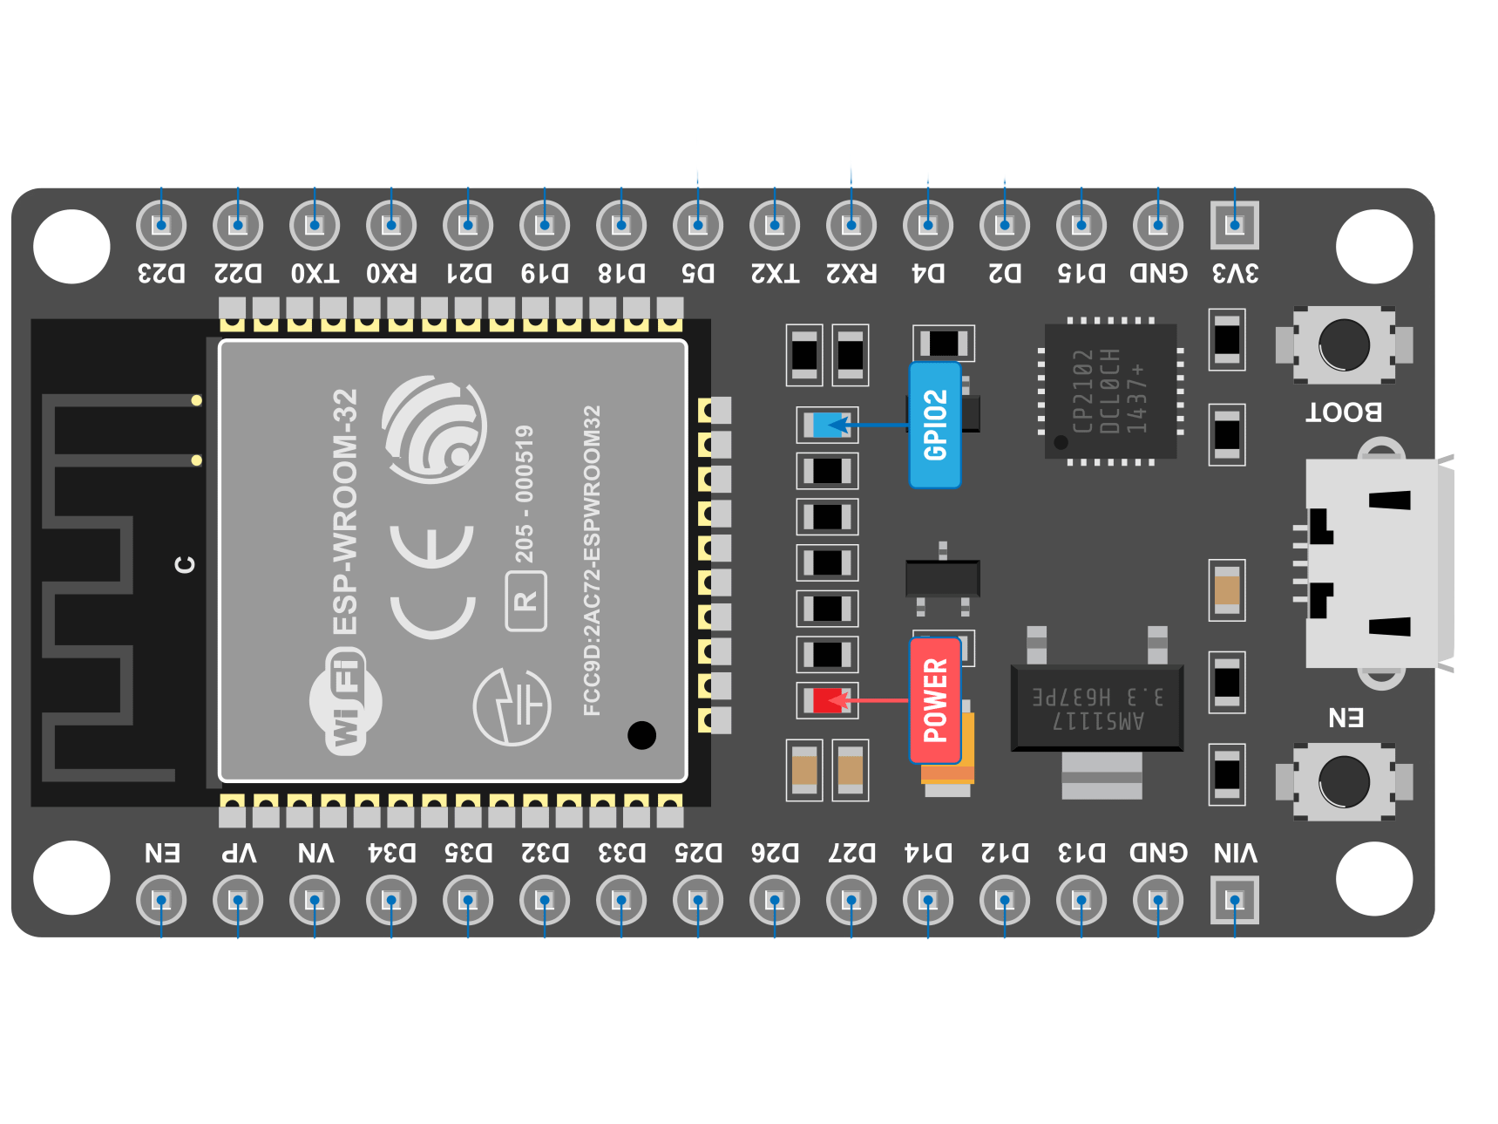

Arduino
Python
Object Detection
NG
-Missing Object
-Wrong Object
Good
-All Object Is Present
Reset
-If Empty

Slide 9
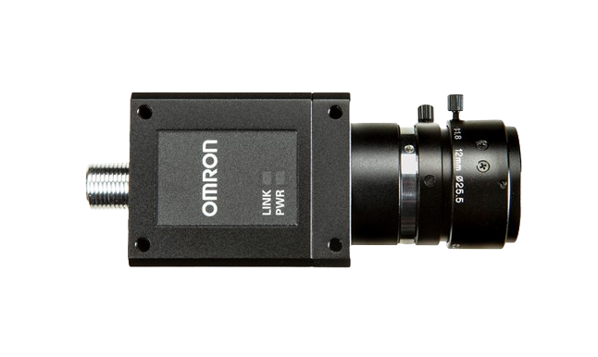
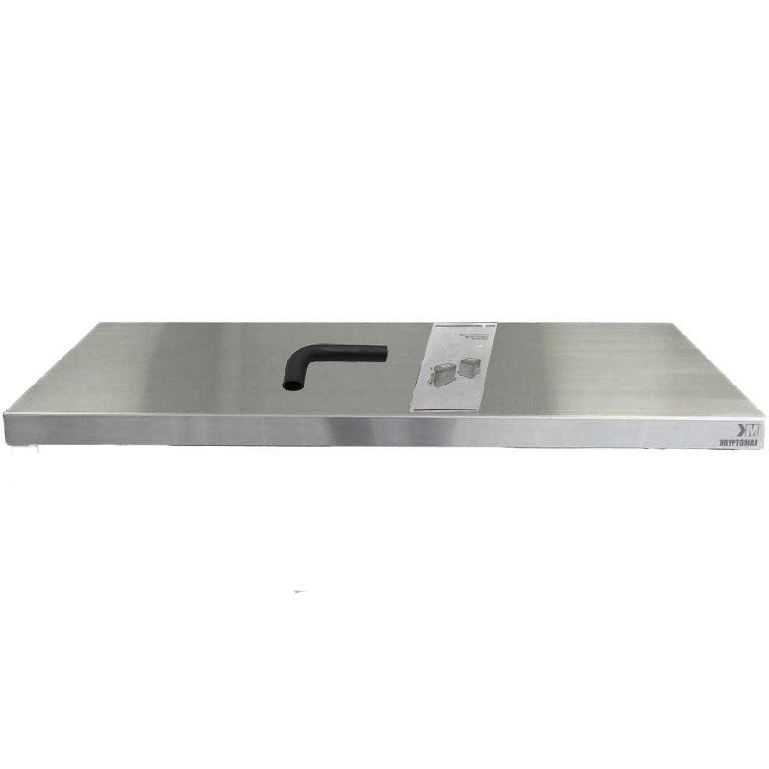
- Accessories Presence
- Correct Hose (Lhose/Straighthose)
- L hose Clip Diameter

Slide 10
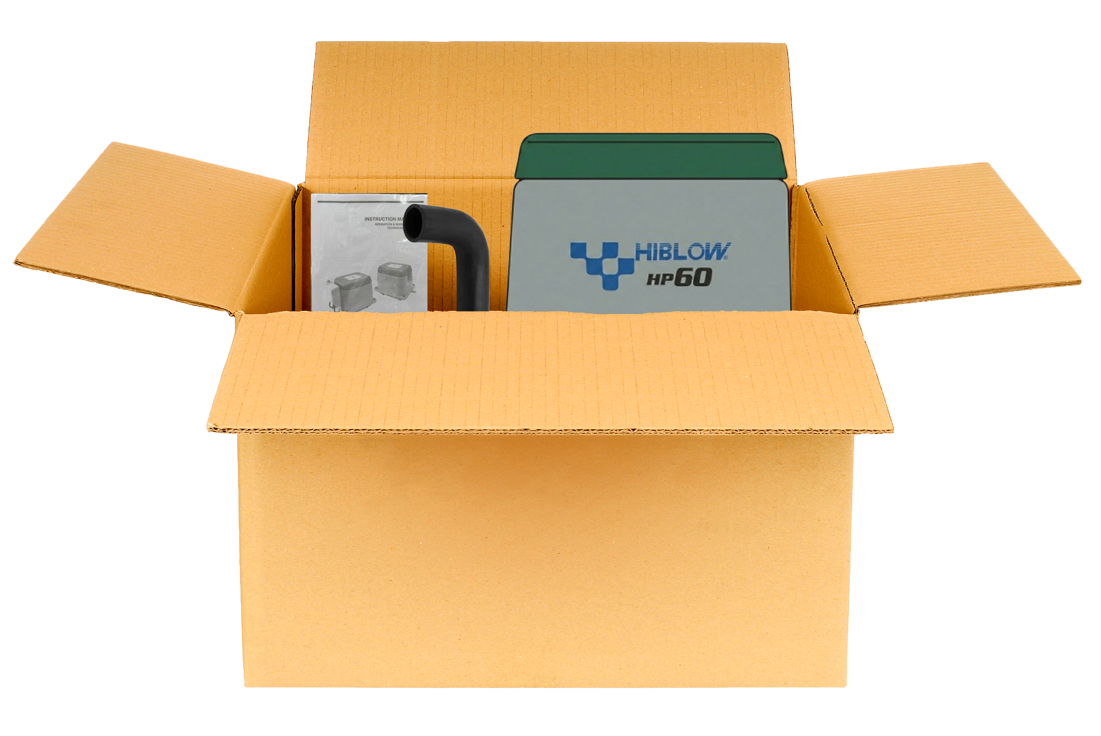
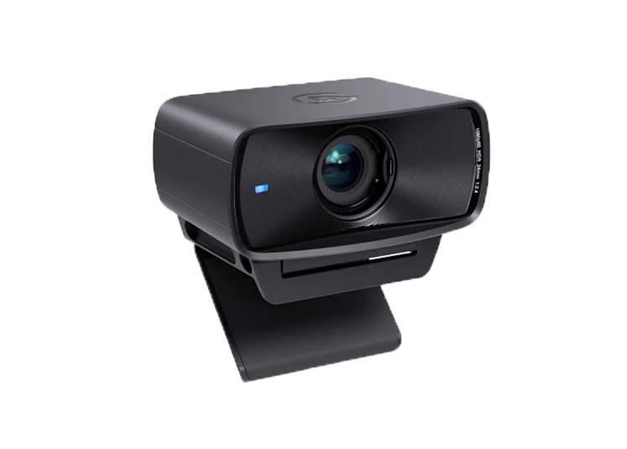
-Check Pump, Manual,
L Hose Presence In Packing
Webcam
-Check Stamp Both Sides

Slide 11
THANK YOU
FOR LISTENING !

